Slide 1
Fastai Lesson 9 Review
THIS IS YOUR PRESENTATION TITLE
Joseph Catanzarite
For TWiML fastai study group meetup
Saturday, 8/03/2019

Slide 2
Review 03_minbatch_training notebook
Top down 9a code review
Build training/validation pipeline
Refactor
Readability
Robustness
Compactness
Flexibility
Modifiability
Recreate PyTorch functionality
Bottom up 9a code review
loss_func()
F.cross_entropy()
LogSumExp()

Slide 3
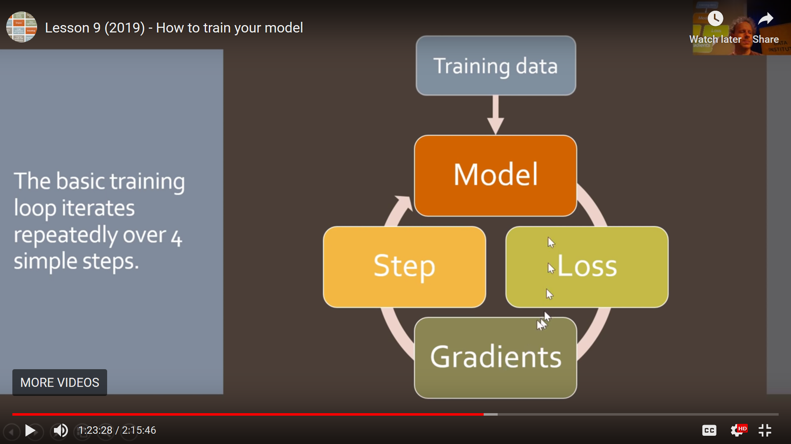

Slide 4
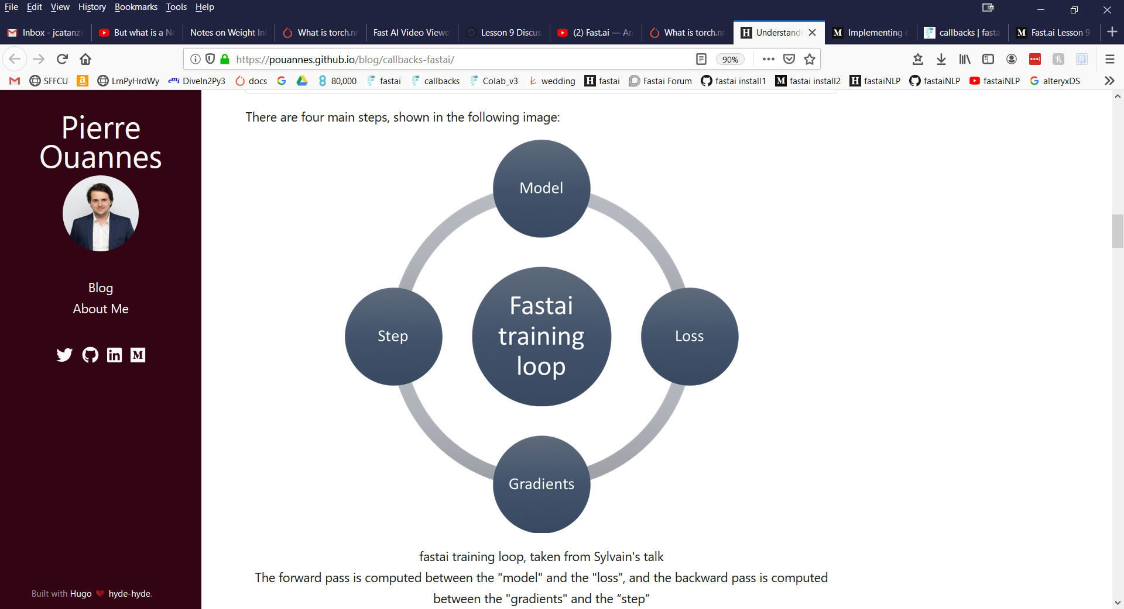
Training Loop
Update parameters
Forward pass
Compute step via optimizer
Backward pass

Slide 5
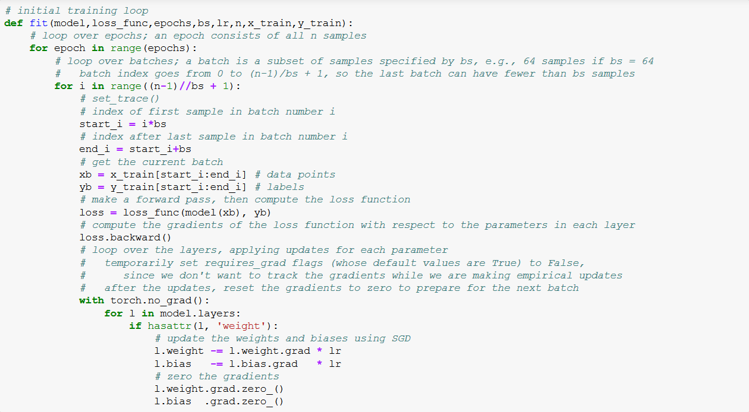
Training Loop

Slide 6
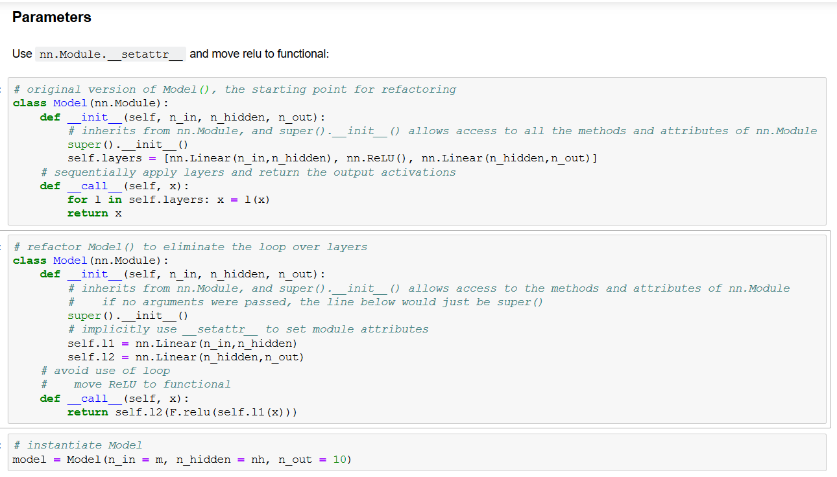
Refactor Model()

Slide 7
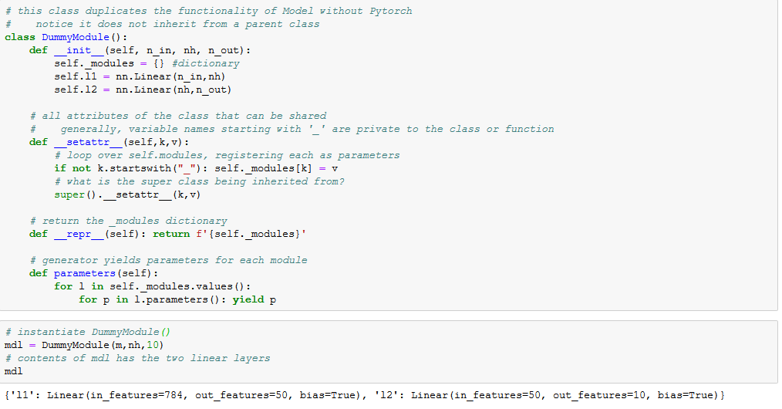
Modules dictionary, parameter generator

Slide 8
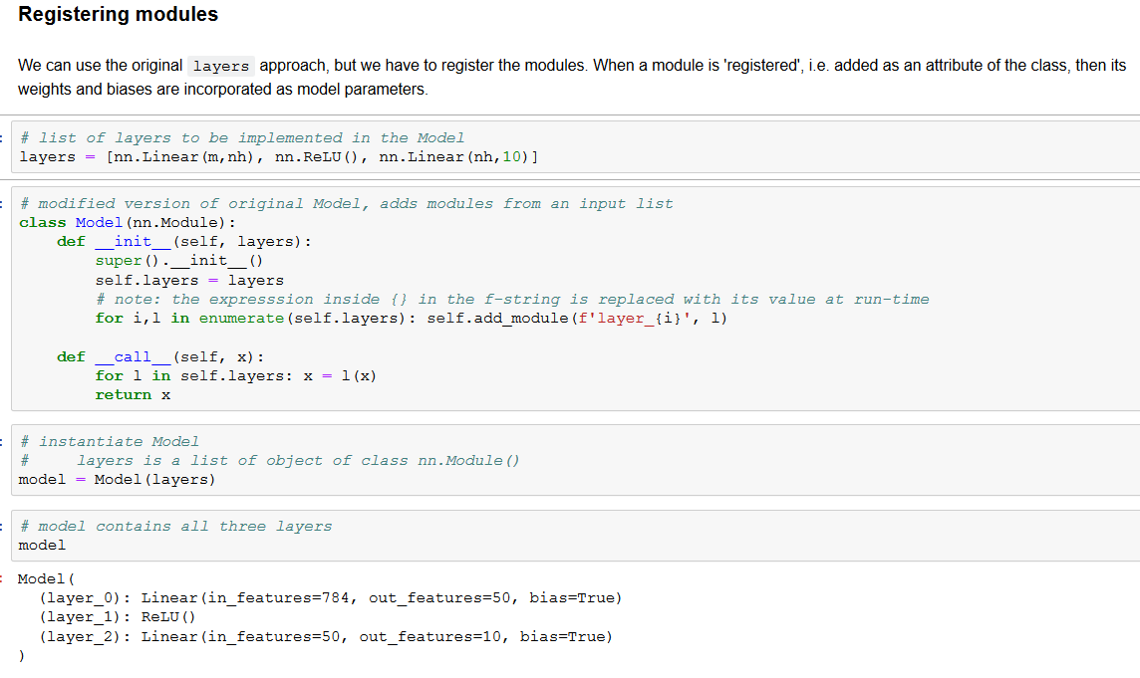
Registering modules

Slide 9
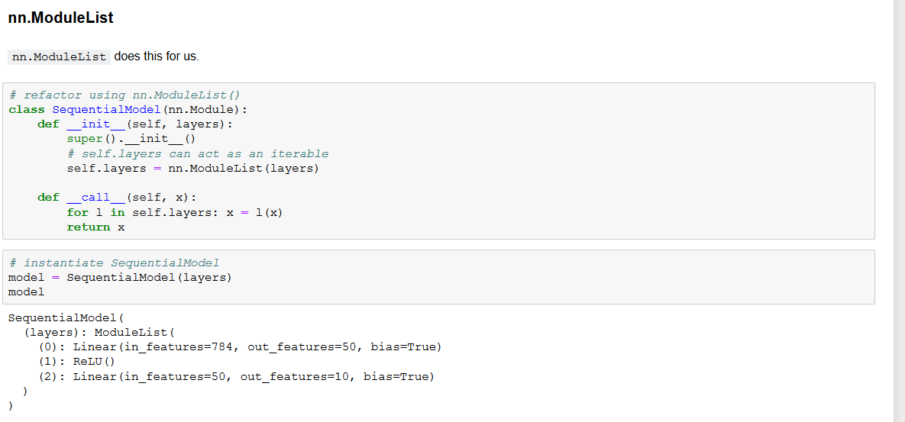
Use PyTorch nn.ModuleList()

Slide 10
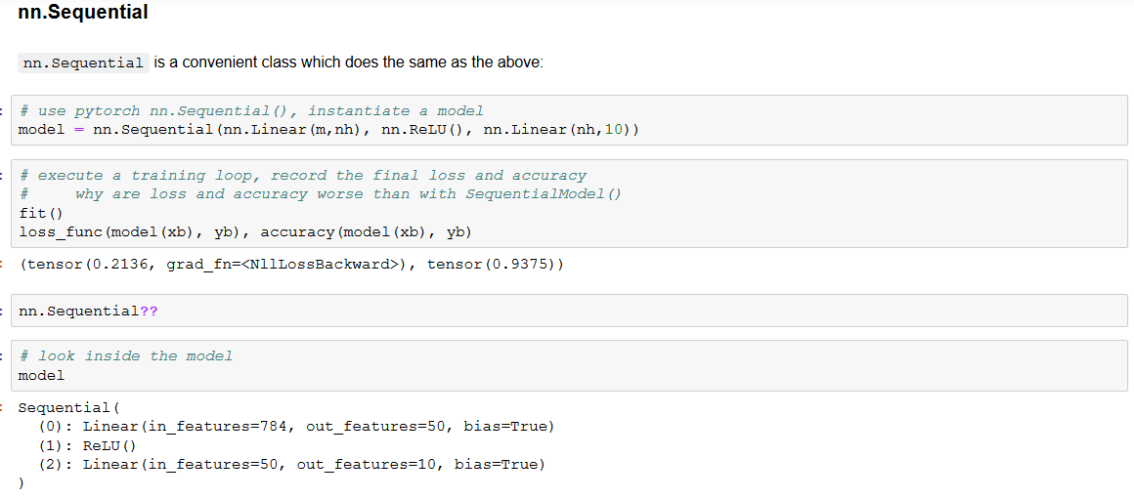
Use PyTorch nn.Sequential()

Slide 11
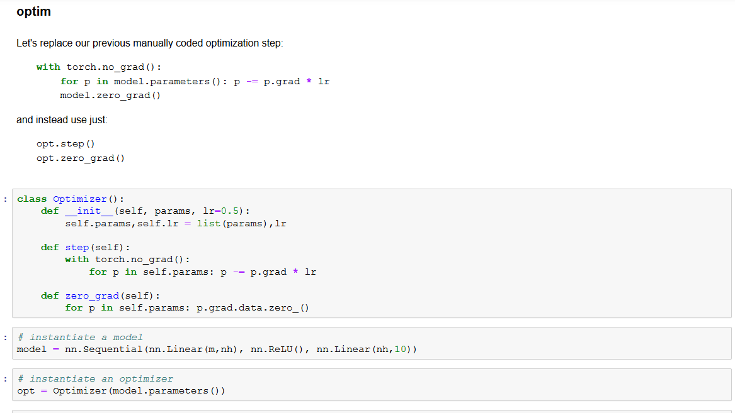
Create Optimizer Class

Slide 12
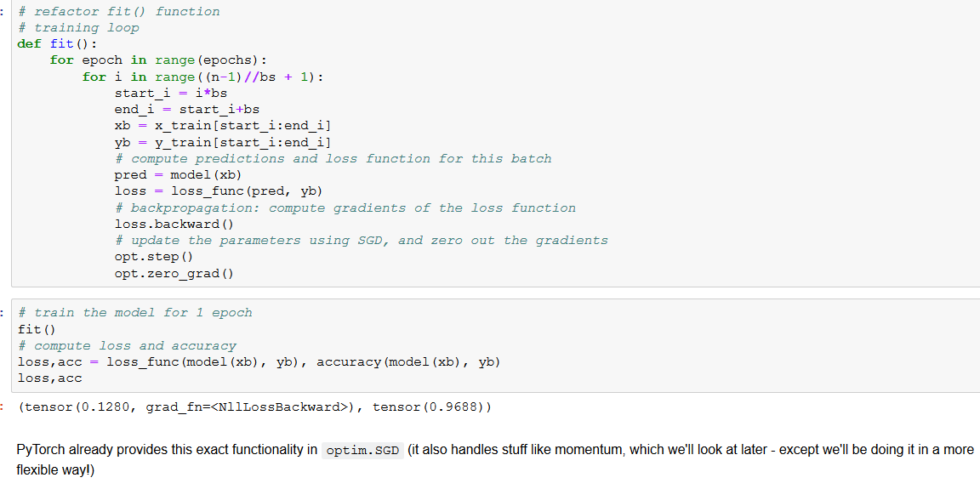
Refactor Model() to use Optimizer

Slide 13
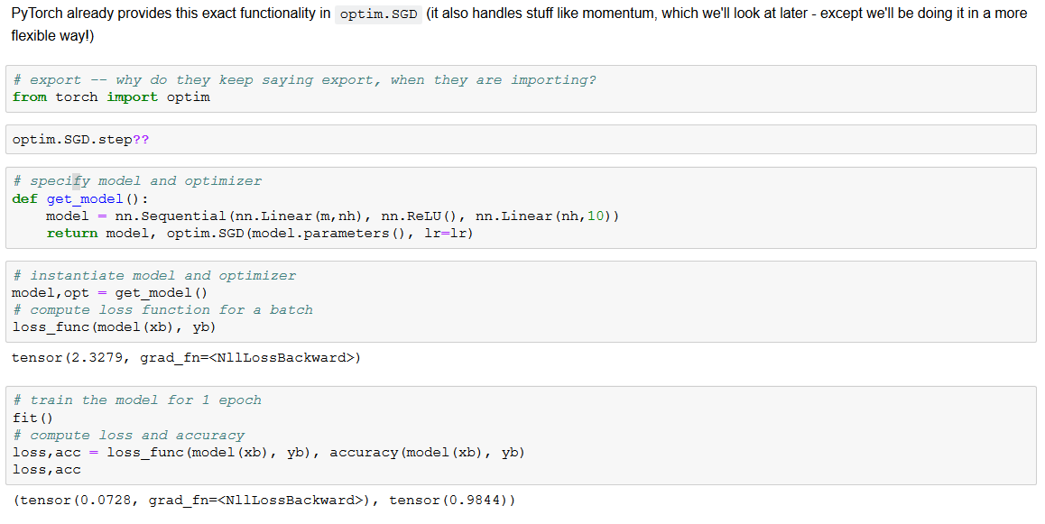
Use PyTorch optim

Slide 14
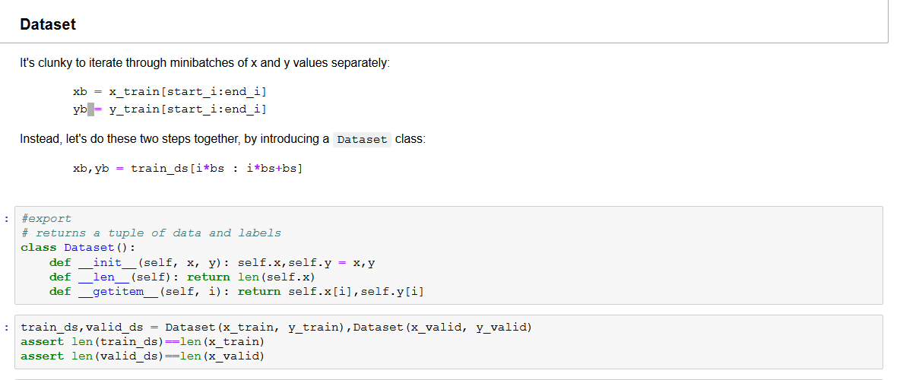
Add Dataset Class

Slide 15
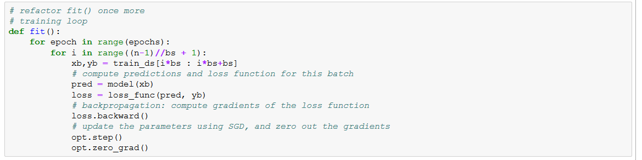
Refactor Model()

Slide 16
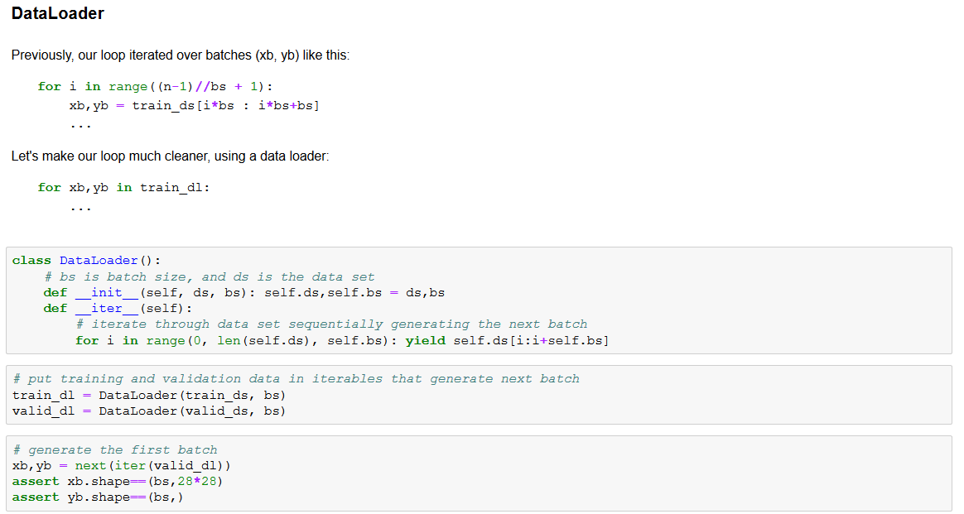
Add DataLoader Class

Slide 17
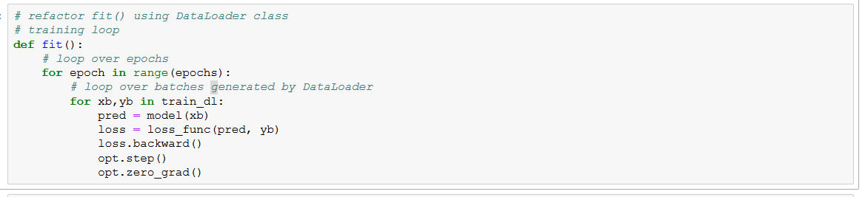
Refactor using DataLoader Class

Slide 18
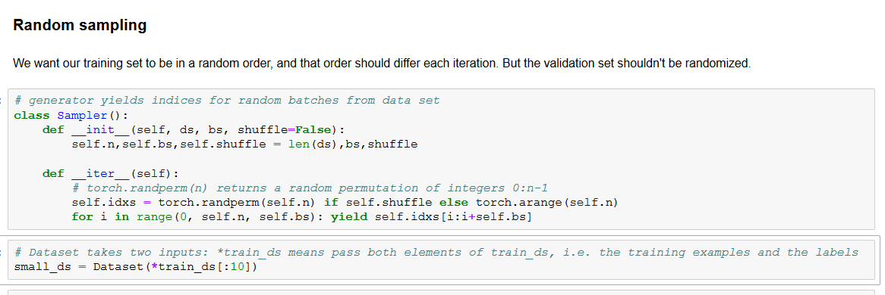
Random Sampling

Slide 19
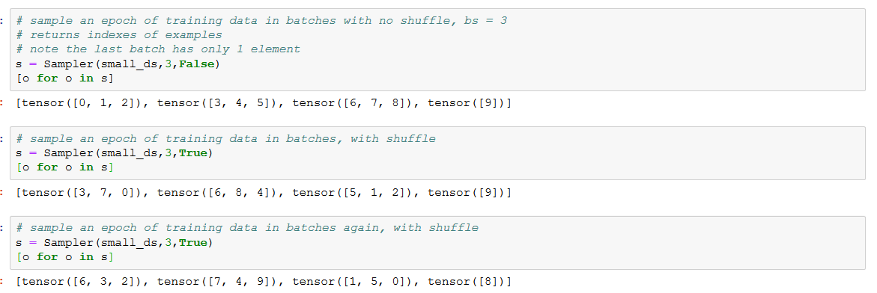
Using the Sampler Class

Slide 20
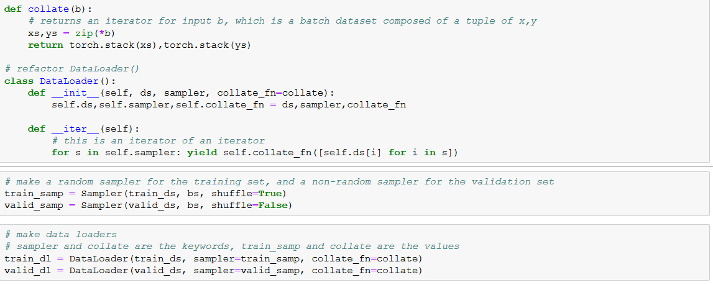
Refactor DataLoader to use Sampler

Slide 21
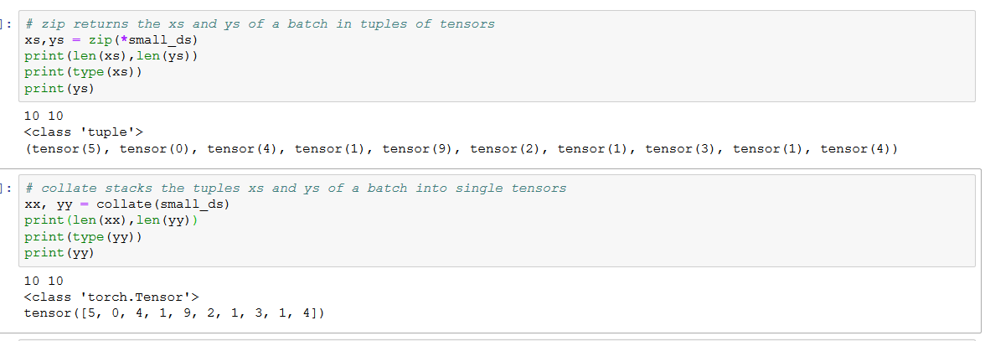
What happens Inside DataLoader

Slide 22
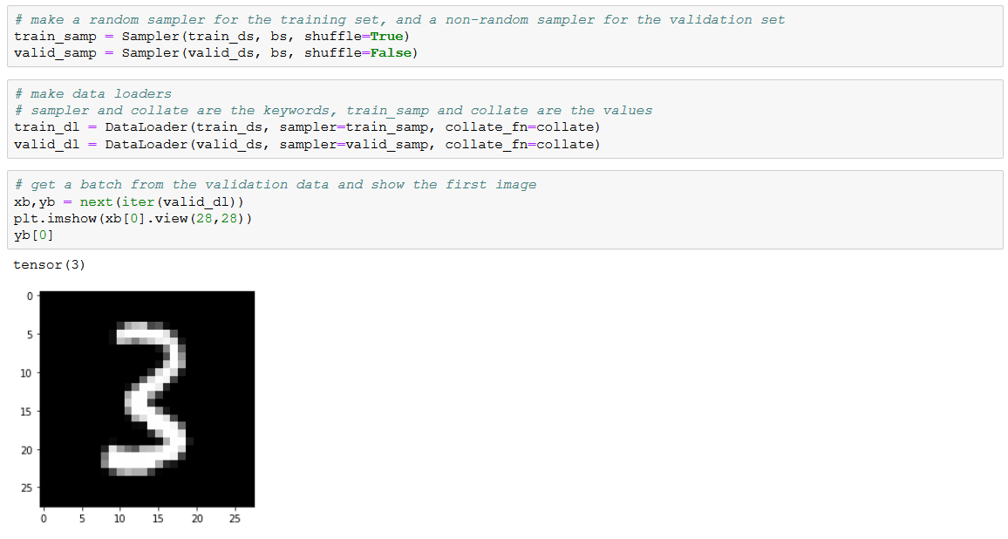
Using DataLoader

Slide 23
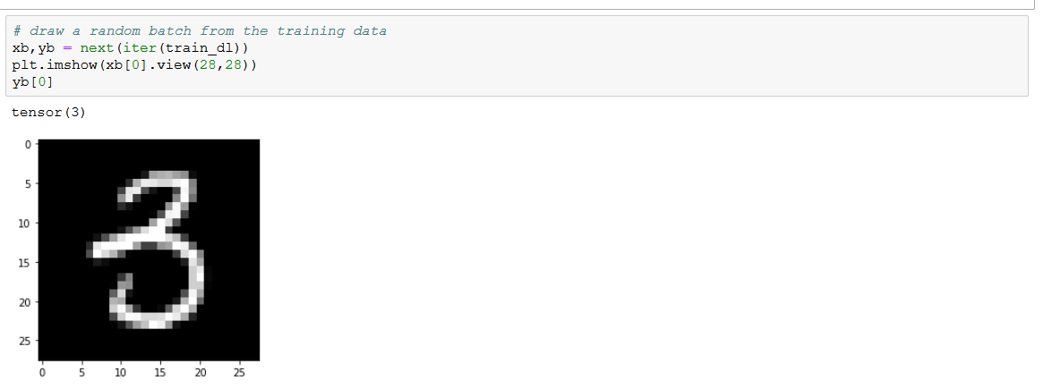
Using DataLoader, cont’d

Slide 24
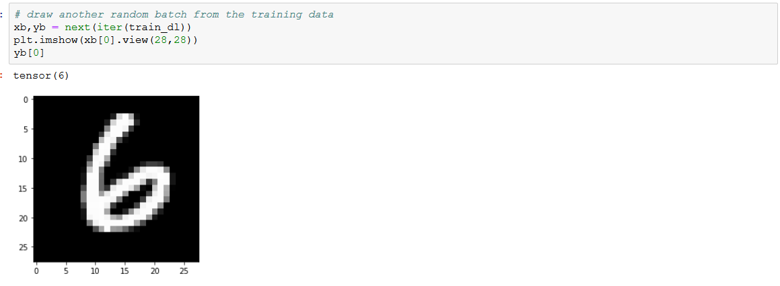
Using DataLoader, cont’d

Slide 25
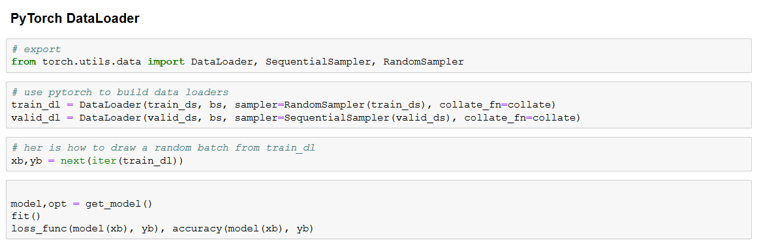
PyTorch DataLoader

Slide 26
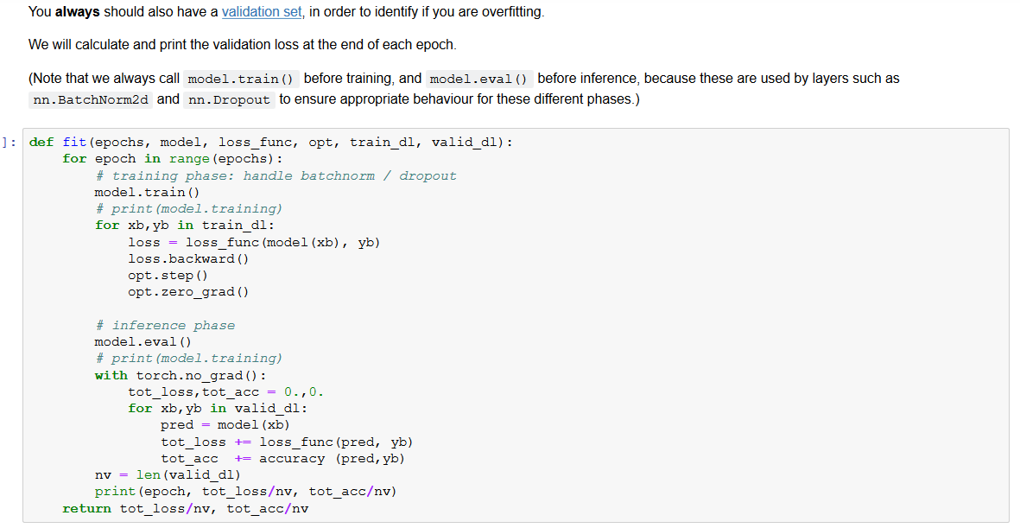
Refactor fit()

Slide 27
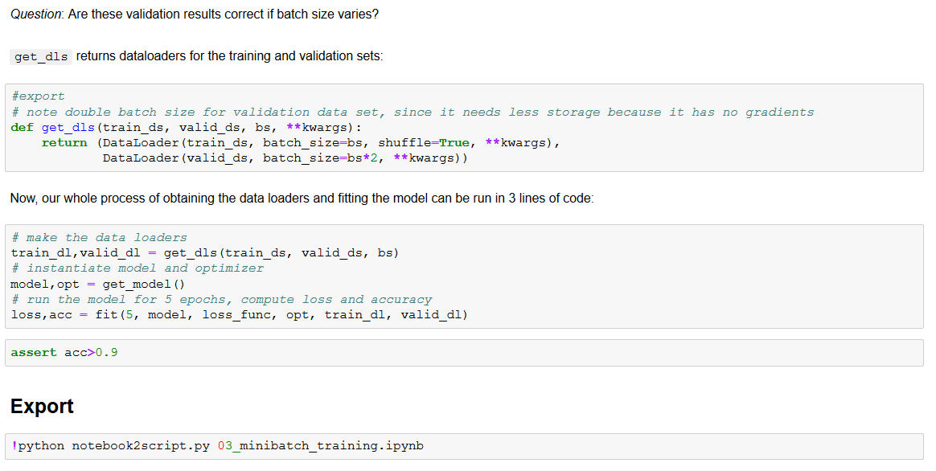
Refactored pipeline

Slide 28
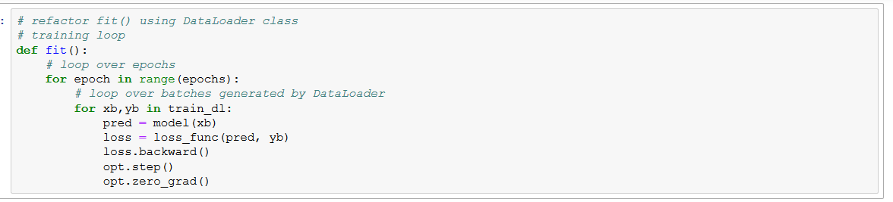
Refactor to use DataLoader class

Slide 29
Appendix: PyTorch classes
Class torch.nn()
Class torch.nn.Module()
Class torch.nn.Linear()
Class torch.nn.functional()
torch.nn.parameter()
Class Optimizer: torch.optim()
Class Data set: TensorDataSet()
Class Data loader: DataLoader():
shuffle option
batch size
**kwargs()

Slide 30
Appendix: functions
PyTorch torch.nn.functional module contains
activation functions, loss functions, etc.
non-stateful versions of layers, such as convolutional and linear layers
import torch.nn.functional as F
F.relu()
F.nll_loss()
F.log_softmax()
F.cross_entropy() is the same as F.nll_loss(F.log_softmax(pred,-1),y_train)
loss_func = F.cross_entropy

Slide 33
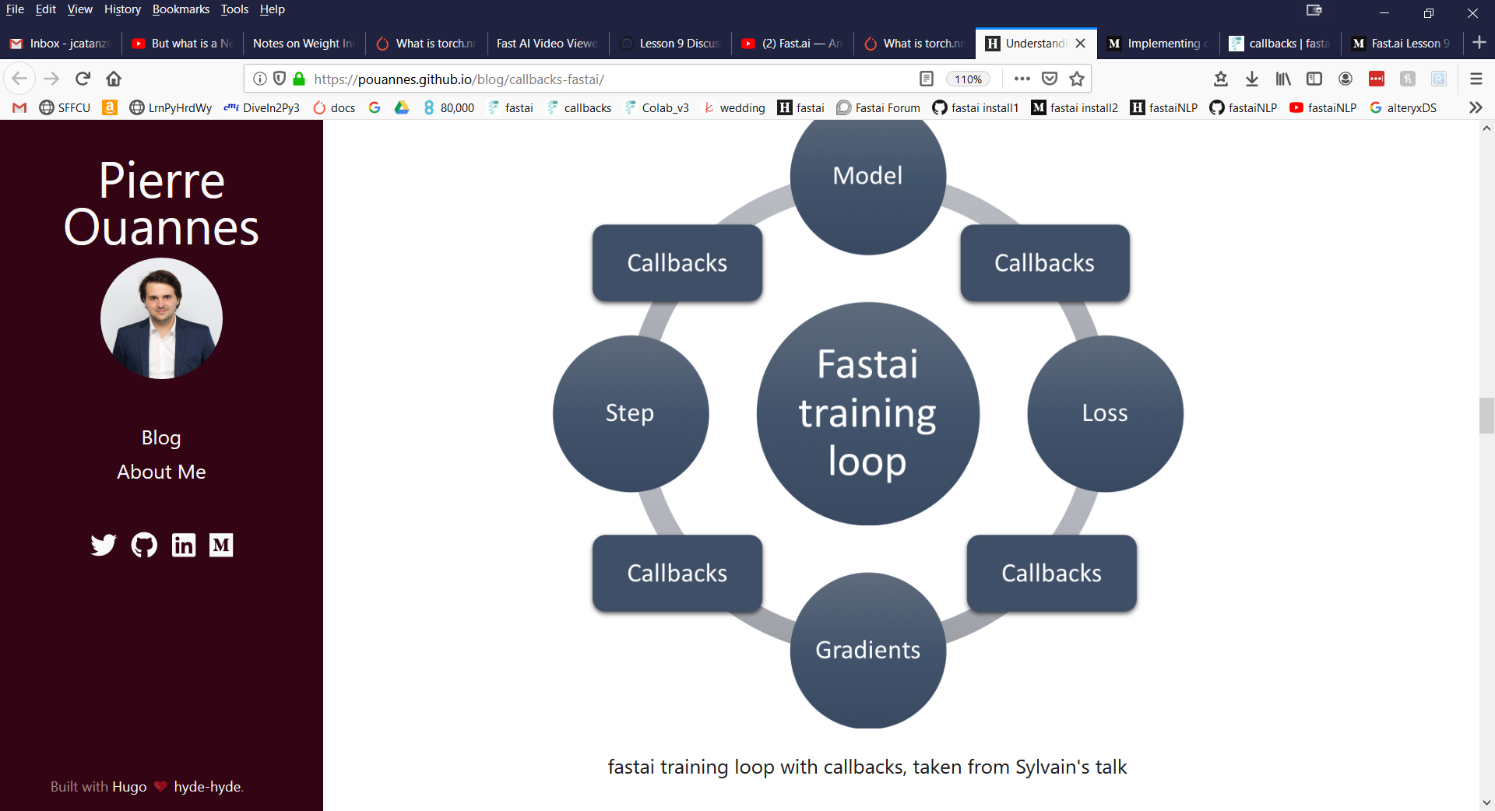

Slide 34
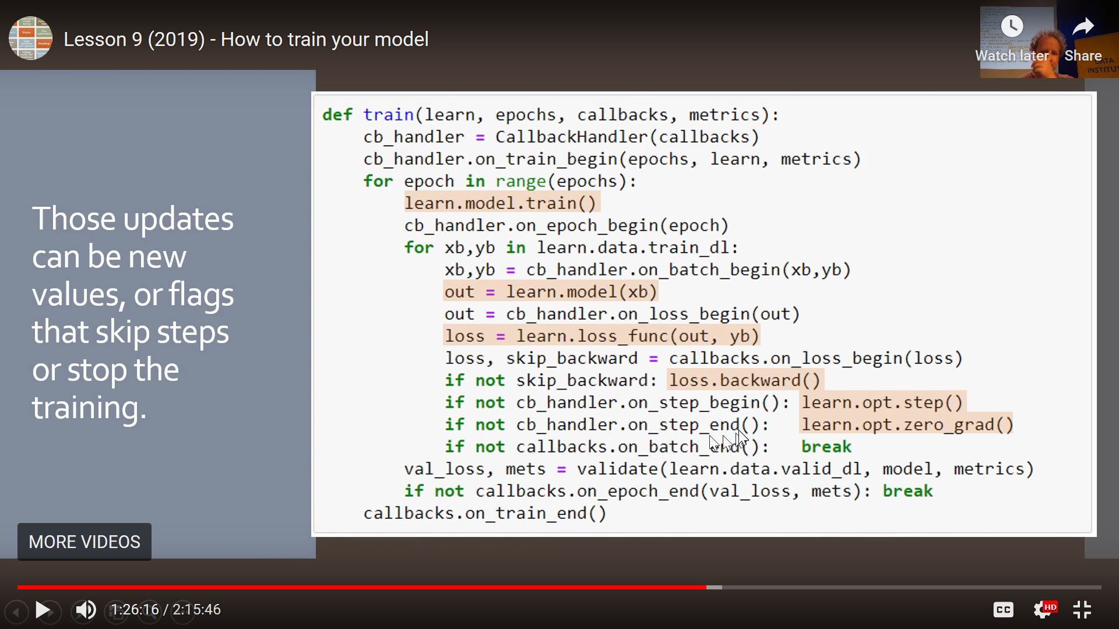

Slide 35
